Slide 1
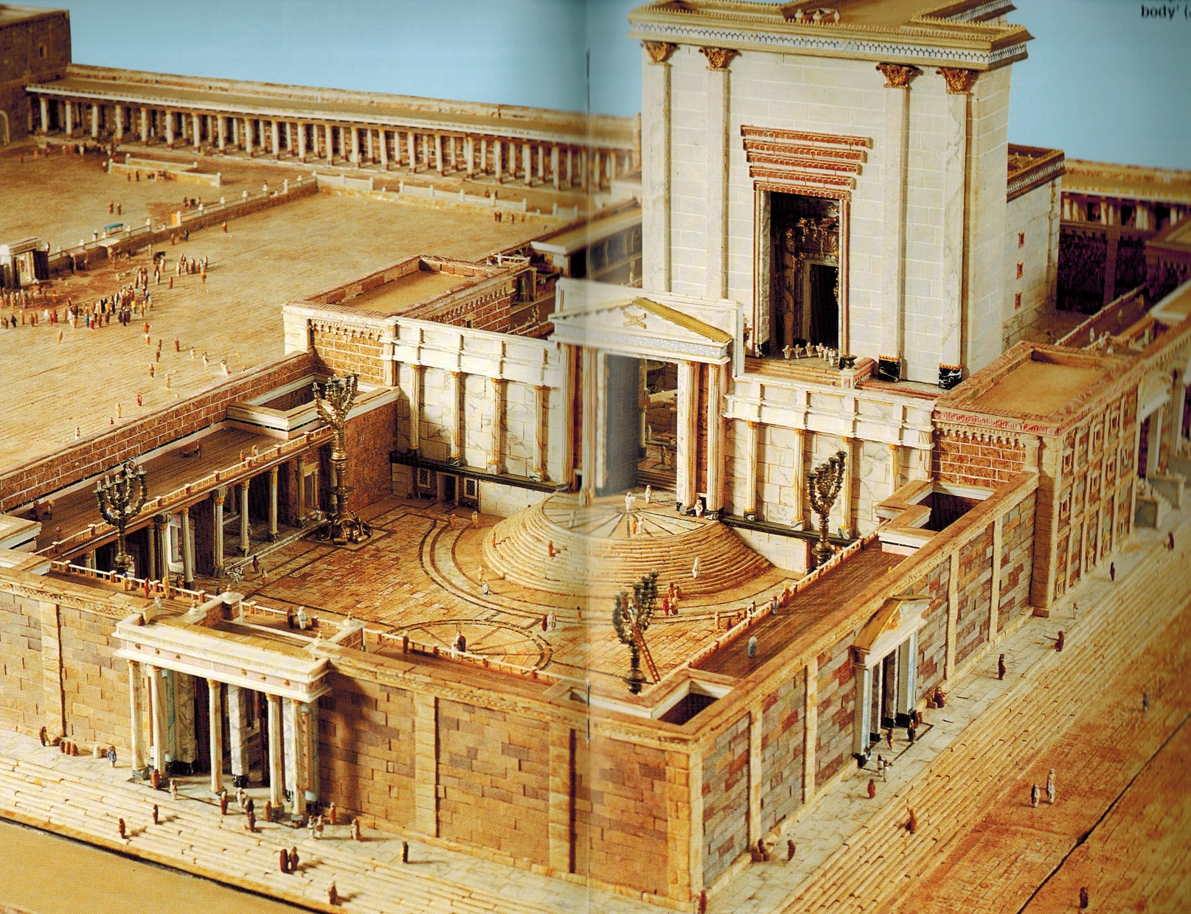
John 10.22-42 NET
Photo from Backhouse: The Jerusalem Temple

Slide 2
Solomon’s Portico
John 10.22-23 NET: Then came the feast of the Dedication in Jerusalem. It was winter, and Jesus was walking in the temple area in Solomon's Portico.

Slide 3
John 10.24: The Jewish leaders surrounded him and asked, “How long will you keep us in suspense? If you are the Christ, tell us plainly.”

Slide 4
John 10.25-26: Jesus replied, “I told you and you do not believe. The deeds I do in my Father's name testify about me. But you refuse to believe because you are not my sheep.”

Slide 5
John 10.27-30: “My sheep listen to my voice, and I know them, and they follow me. I give them
eternal life, and they will never perish; no one will snatch them from my hand.
My Father, who has given them to me, is greater than all, and no one can snatch them from my Father's hand. The Father and I are one.”

Slide 6
John 10.27-30: “My sheep listen to my voice, and I know them, and they follow me. I give them
eternal life, and they will never perish; no one will snatch them from my hand.
I give eternal life to them and
they certainly will not perish into eternity!
My Father, who has given them to me, is greater than all, and no one can snatch them from my Father's hand. The Father and I are one.”

Slide 7
John 10.27-30: “My sheep listen to my voice, and I know them, and they follow me. I give them
eternal life, and they will never perish; no one will snatch them from my hand.
My Father, who has given them to me, is greater than all, and no one can snatch them from my Father's hand. The Father and I are one.”
In Greek: one thing, not one person

Slide 8
John 10.31-33: The Jewish leaders picked up rocks again to stone him to death. Jesus said to them, “I have shown you many good deeds from the Father. For which one of them are you going to stone me?” The Jewish leaders replied, “We are not going to stone you for a good deed but for blasphemy, because you, a man, are claiming to be God.”

Slide 9
John 10.34-36: Jesus answered, “Is it not written in your law, ‘I said, you are gods’?
If those people to whom the word of God came were called ‘gods’ (and the scripture cannot be broken), do you say about the one whom the Father set apart and sent into the world, ‘You are blaspheming,’ because I said, ‘I am the Son of God’?”

Slide 10
John 10.34-36: Jesus answered, “Is it not written in your law, ‘I said, you are gods’?
quotation of Psalm 82.6
The Jewish Scriptures = our Old Testament
If those people to whom the word of God came were called ‘gods’ (and the scripture cannot be broken), do you say about the one whom the Father set apart and sent into the world, ‘You are blaspheming,’ because I said, ‘I am the Son of God’?”

Slide 11
John 10.34-36: Jesus answered, “Is it not written in your law, ‘I said, you are gods’?
Psalm 82.6: “I myself said, ‘You are gods,
and all sons of the Most High.’”
They represent God, so “sons” of God, so “gods”
If those people to whom the word of God came were called ‘gods’ (and the scripture cannot be broken), do you say about the one whom the Father set apart and sent into the world, ‘You are blaspheming,’ because I said, ‘I am the Son of God’?”

Slide 12
John 10.34-36: Jesus answered, “Is it not written in your law, ‘I said, you are gods’?
In Psalm 82.6: God was angry with these “gods”
for failing to represent God and uphold justice,
so God condemned them and
would administrate over his people himself.
If those people to whom the word of God came were called ‘gods’ (and the scripture cannot be broken), do you say about the one whom the Father set apart and sent into the world, ‘You are blaspheming,’ because I said, ‘I am the Son of God’?”

Slide 13
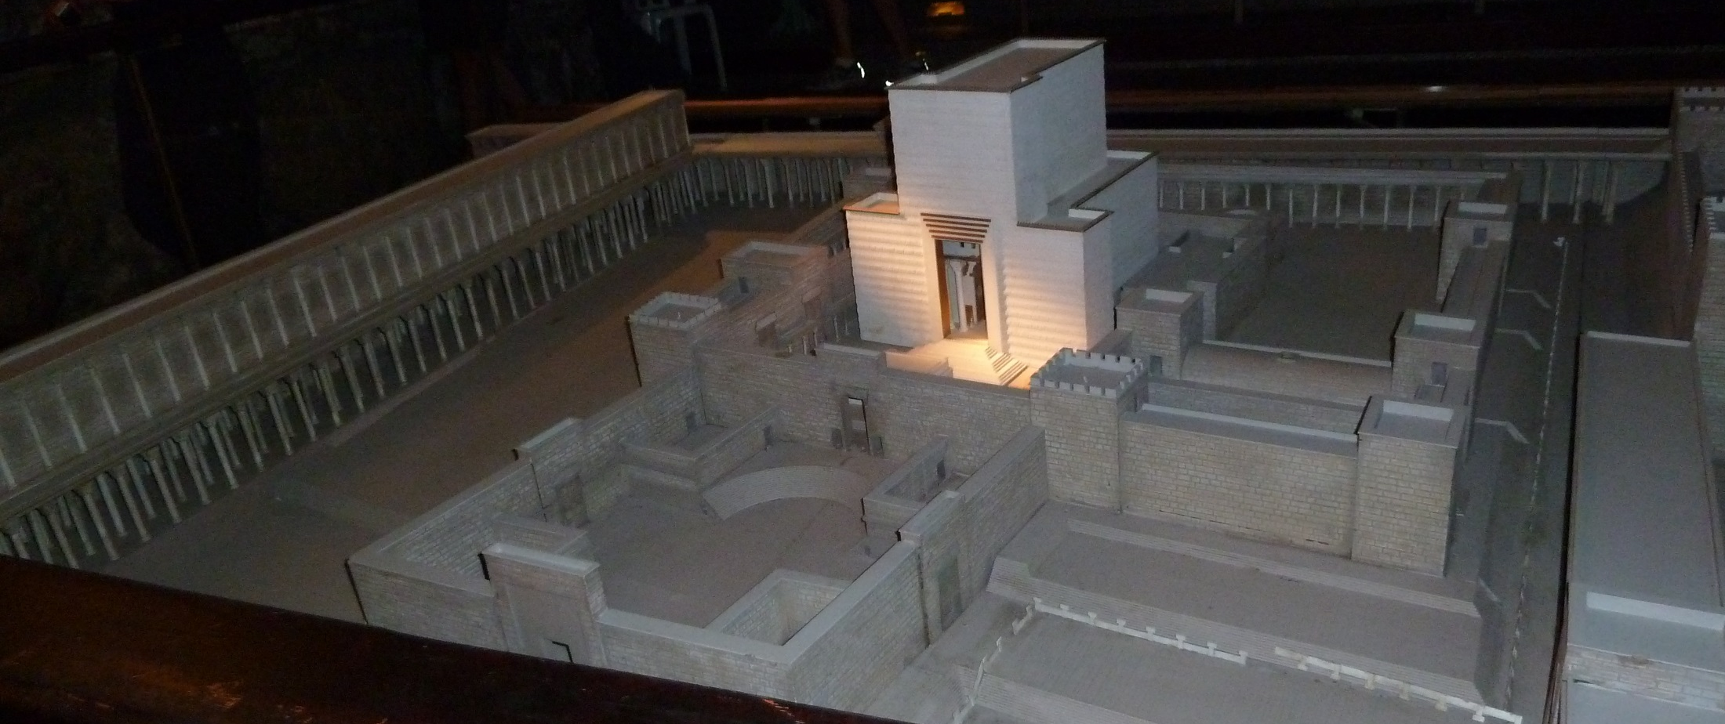
John 10.37-39: “If I do not perform the deeds of my Father, do not believe me. But if I do them, even if you do not believe me, believe the deeds, so that you may come to know and understand that I am in the Father and the Father is in me.” Then they attempted again to seize him, but he escaped their clutches.

Slide 14
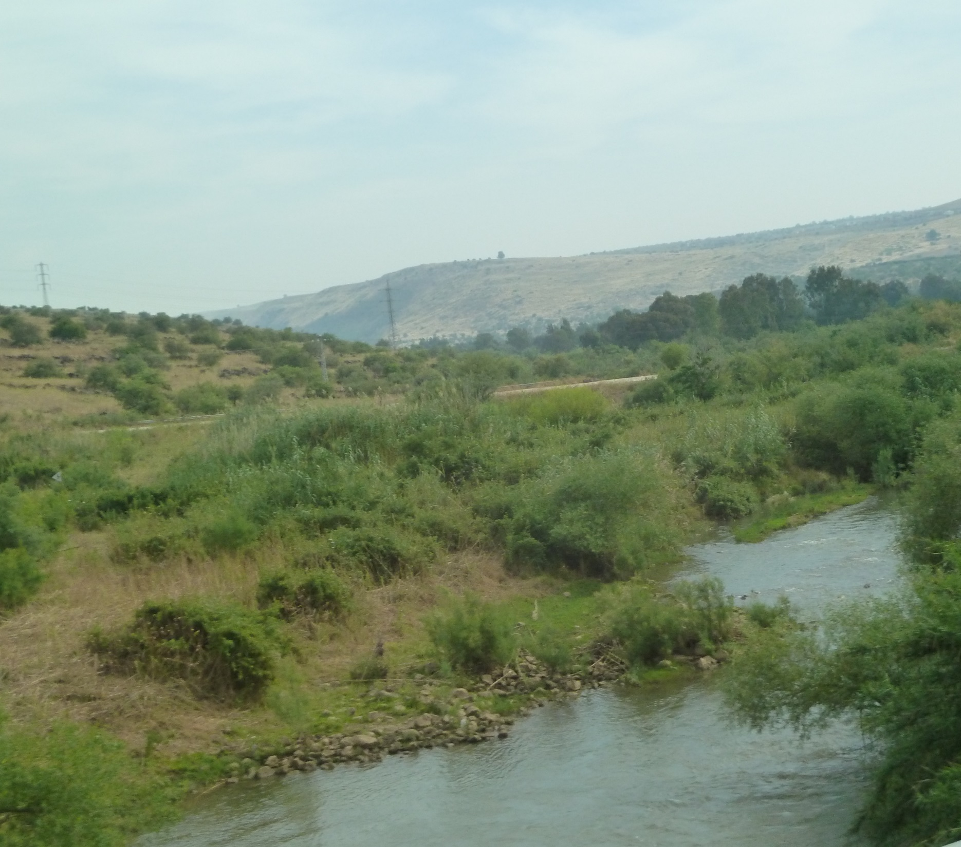
John 10.40-42: Jesus went back across the Jordan River again to the place where John had been baptizing at an earlier time, and he stayed there. Many came to him and began to say, “John performed no miraculous sign, but everything John said about this man was true!” And many believed in Jesus there.

Slide 15
God gives you to Jesus and grace to you.
You heal from spiritual blindness.
You choose to believe in Jesus.
You follow Jesus
and start to grow.
You receive eternal life.

Slide 16
God gives you to Jesus.
Nothing/Nobody can tear you away.
God gives you grace
based on Christ’s righteousness.
You cannot
un-earn it.
Jesus promised eternal life.
You can
count on it.

